Slide 1
GCBASIC
PIC16Fxxxx chip Family ( Legacy )
Part 5 – using digital input

Slide 2
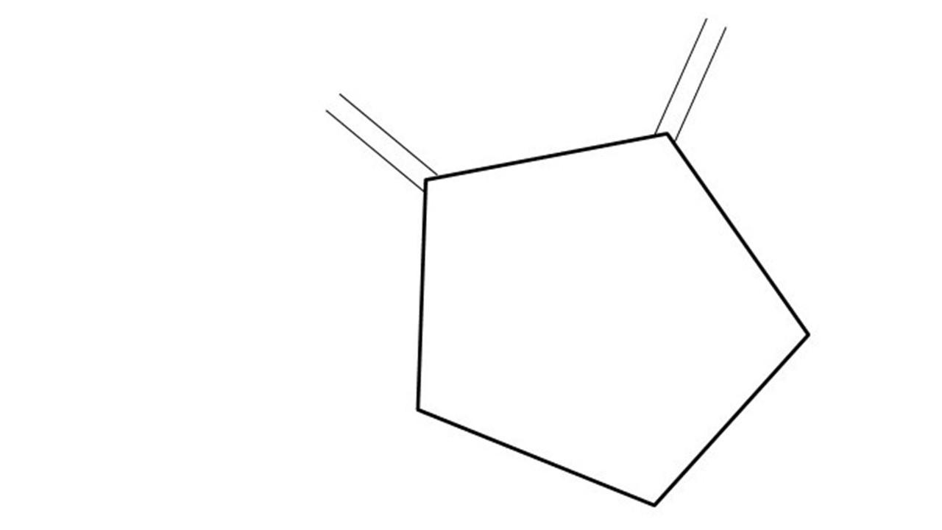
GCBASIC
PIC16Fxxxx chip Family ( Legacy )
Part 5 – using digital input
January 2025

Slide 3
GCBASIC
Like and subscribe!

Slide 4
PIC16Fxxxx
PIC16Fxxxx is a high performance PIC16
Digital and Analog peripherals
8 –bit or 10-bit ADC
Multiple communication interfaces
Serial, I2C and SPI
PWM – CCP/PWM and 16Bit
The PIC16 offers 8, 14,18,20, 28, 40 and 48-pin packages to support customers in a wide variety of applications.

Slide 5
Videos...
Install the hardware and make the board work – make LEDs work
Make four LEDs flash in a sequence
Set the LEDs to represent the value of ADC
Sequence the LEDs with a delay using the value of ADC
Using an input to set the state of the LEDs
Using the reset switch
Using the switch, ADC – make the LEDs flash in a sequence with reverse
Using the serial to display values
Using the timer0 overflow, 8bit timer, 16bit timer to flash the LEDs
Using EEProm – showing values on the serial terminal, and more constants insights
Using I2C with serial to discover I2C devices
Using an I2C GCLD display
Using a SPI GCLD display
Using PWM, many ways, to dim the LEDS
Using an external interrupt to control an LED
Using storage within the chip – Progmem, EEPROM and DATA blocks
The GCBASIC tool chain
Assembly , alternatives assemblers and MPLAB-X
Summary

Slide 6
GCBASIC Compiler
GCBASIC Compiler
GCBASIC is an Open Source compiler for PIC, AVR and LGT microcontrollers
GCBASIC supports the 16Fxxxx chip family

Slide 7
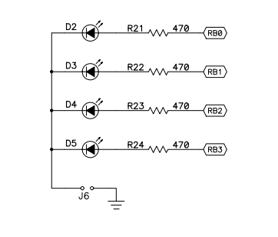
Prerequisites
Assumes you have
Installed the GCBASIC software
Installed your programmer software
Test that you have the PIC attached
You have the 4 LEDs operating
You have a POT connected
You have switch connected

Slide 8
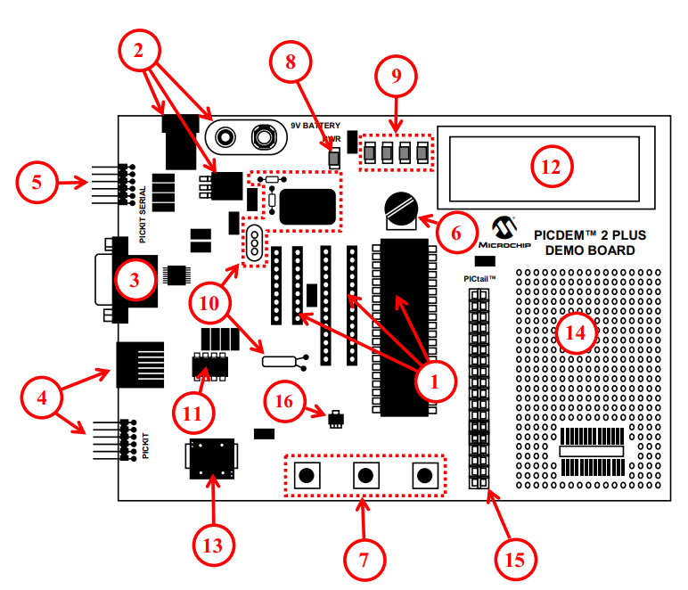
Hardware
The PICDEM 2 Plus Demonstration Board
18-, 28- and 40-pin DIP sockets (although three sockets are provided, only one device may be used at a time)
On-board, +5V regulator for direct input from 9V, 100 mA AC/DC wall adapter or 9V battery, or hooks for a +5V, 100 mA regulated DC supply
RS-232 socket and associated hardware for direct connection to an RS-232 interface
Programmer/debugger connectivity supporting MPLAB® ICD 3, MPLAB REAL ICE, PICkit 2 and PICkit 3
PICkit Serial Connector for analysis of serial communications peripherals such as SPI or I2C™
5 k pot for devices with analog inputs
Three push button switches for external stimulus and Reset
Power-on indicator LED
Four LEDs connected to PORTB
On-board external oscillators including: a) Unpopulated DIP socket for canned crystal oscillator (Y2) b) RC oscillator circuit (R4, C3) c) Unpopulated holes for crystal connection (Y1) d) 32.768 kHz crystal for Timer1 clock operation (Y3)
32K x 8 Serial EEPROM
LCD display
Piezo buzzer
Prototype area for user hardware
Expansion Header for PICtail™ daughter card connectivity or user access to
MCUs
Microchip TC74 thermal sensor

Slide 9
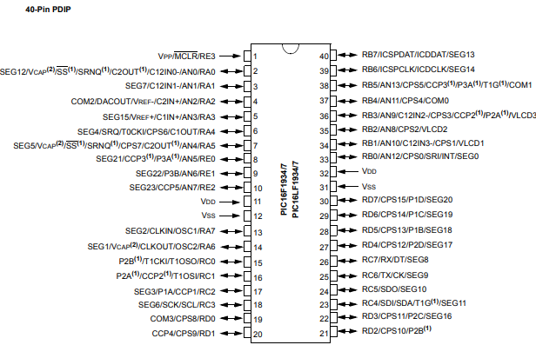
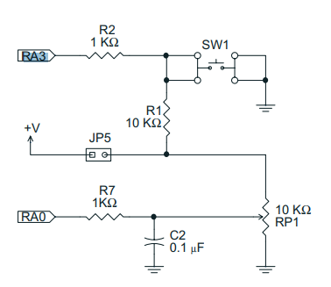
Hardware
Switch
SWITCH
RA4

Slide 10
Hardware
Hardware
------------PORTA---------------
Bit#: -7---6---5---4---3---2---1---0---
IO: ------------SW2-------------ADC--
IO: ---------------------------------
------------PORTB----------------
Bit#: -7---6---5---4---3---2---1---0---
IO: ----------------LED-LED-LED-LED--
IO: ---------------------------------
------------PORTC----------------
Bit#: -7---6---5---4---3---2---1---0---
IO: --------------------------------
IO: ---------------------------------
------------PORTD----------------
Bit#: -7---6---5---4---3---2---1---0---
IO: --------------------------------
IO: ---------------------------------
------------PORTE----------------
Bit#: -7---6---5---4---3---2---1---0---
IO: ----------------RST---------------
IO: ---------------------------------
Prototype Board
Power 5v0
Programmer
LEDs & resistors

Slide 11
Tutorial overview
Initialise
Set LEDs off
Keypressed = TRUE
Initialise microcontroller
Check the switch
If pushed then toggle LED
If not pushed then do it again
Checking the switch by using function to inspect the switch state
Repeat
Yes
No
Toggle LEDs
Loop

Slide 12
Lab
Review GCSTUDIO options
Examine the sample code
Review the results

Slide 14
Videos...
Install the hardware and make the board work – make LEDs work
Make four LEDs flash in a sequence
Set the LEDs to represent the value of ADC
Sequence the LEDs with a delay using the value of ADC
Using an input to set the state of the LEDs
Using the reset switch
Using the switch, ADC – make the LEDs flash in a sequence with reverse
Using the serial to display values
Using the timer0 overflow, 8bit timer, 16bit timer to flash the LEDs
Using EEProm – showing values on the serial terminal, and more constants insights
Using I2C with serial to discover I2C devices
Using an I2C GCLD display
Using a SPI GCLD display
Using PWM, many ways, to dim the LEDS
Using an external interrupt to control an LED
Using storage within the chip – Progmem, EEPROM and DATA blocks
The GCBASIC tool chain
Assembly , alternatives assemblers and MPLAB-X
Summary

Slide 15
GCBASIC
PIC16Fxxxx chip Family ( Legacy )
Part 5 – using digital input

Slide 16
// Function to debounce a switch and return the stable state
Function DebounceSwitch as Bit
// Define variables
Dim CurrentState As Bit
Dim LastState As Bit
Dim StableState As Bit
Dim Counter As Byte
// Initialize states and counter
LastState = SWITCHIN
StableState = LastState
Counter = 0
// Debounce loop: checks the state multiple times to ensure stability
For Counter = 0 To 10
wait 5 ms // Small delay to allow switch to settle
// Read the current state of the switch
CurrentState = SWITCHIN
// If the state is stable (consistent for the duration of the loop)
If (CurrentState = LastState) Then
StableState = CurrentState
Else
// Reset counter if state changes
Counter = 0
LastState = CurrentState
End If
Next
// Return the stable state of the switch
DebounceSwitch = StableState
End Function
Explanation:
Variable Definition:
CurrentState, LastState, and StableState are declared as Bit to store the current, previous, and stable states of the switch.
Counter is declared as Byte to act as a loop counter.
Initialization:
LastState is initialized to the current state of the switch (SWITCHIN).
StableState is initialized to LastState.
Counter is initialized to 0.
Debounce Loop:
The loop runs 10 times, checking the switch state every 5 milliseconds.
CurrentState is updated with the current state of the switch (SWITCHIN).
If the CurrentState matches the LastState consistently for the duration of the loop, StableState is set to CurrentState.
If the state changes, the counter is reset, and LastState is updated with CurrentState.
Return Stable State:
The function returns the StableState of the switch, which has been debounced.
This function ensures that the state of the switch is stable before returning it, effectively debouncing the switch. If you have any further questions or need more details, feel free to let me know! 😊✨

Slide 17
// Function to debounce a switch and return the stable state
Function DebounceSwitch as Bit
// Define variables
Dim CurrentState As Bit
Dim LastState As Bit
Dim StableState As Bit
Dim Counter As Byte
// Initialize states and counter
LastState = SWITCHIN
StableState = LastState
Counter = 0
// Debounce loop: checks the state multiple times to ensure stability
For Counter = 0 To 10
wait 5 ms // Small delay to allow switch to settle
// Read the current state of the switch
CurrentState = SWITCHIN
// If the state is stable (consistent for the duration of the loop)
If (CurrentState = LastState) Then
StableState = CurrentState
Else
// Reset counter if state changes
Counter = 0
LastState = CurrentState
End If
Next
// Return the stable state of the switch
DebounceSwitch = StableState
End Function
Explanation:
Variable Definition:
CurrentState, LastState, and StableState are declared as Bit to store the current, previous, and stable states of the switch.
Counter is declared as Byte to act as a loop counter.
Initialization:
LastState is initialized to the current state of the switch (SWITCHIN).
StableState is initialized to LastState.
Counter is initialized to 0.
Debounce Loop:
The loop runs 10 times, checking the switch state every 5 milliseconds.
CurrentState is updated with the current state of the switch (SWITCHIN).
If the CurrentState matches the LastState consistently for the duration of the loop, StableState is set to CurrentState.
If the state changes, the counter is reset, and LastState is updated with CurrentState.
Return Stable State:
The function returns the StableState of the switch, which has been debounced.
This function ensures that the state of the switch is stable before returning it, effectively debouncing the switch. If you have any further questions or need more details, feel free to let me know! 😊✨
CoPilot AI Generated

